Slide 1
BA Development
Part 1 – SQL: Query execution, Optimizing & tuning
R.Tutt – 16th April 2018

Slide 2
Overview
Basic structure of database tables and indexes.
Different types of indexes.
How SQL finds the data when you execute a query.
Why do some queries work faster than others?
How to take advantage of indexes and table structures to optimize queries.
Methods to tune queries.
Walkthrough practical examples & comparisons.

Slide 3
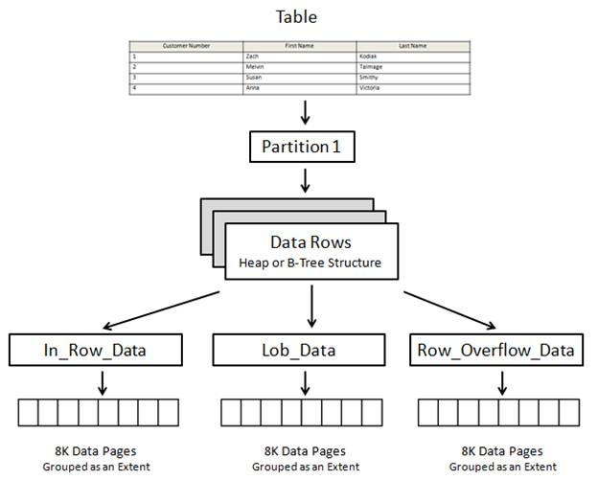
Table Structure
A partition is simply a way for DBAs to sub-divide rows in a table into separate sections for the purpose of spreading rows across more than one file group.
Partitions contain data rows stored in either the physical form of a heap (a table without a clustered index) or a B-Tree structure (a table with a clustered index).
Since a table can’t exist as a bunch of scattered pages, SQL Server provides a way to link them all together so that they act as a single table.

Slide 4
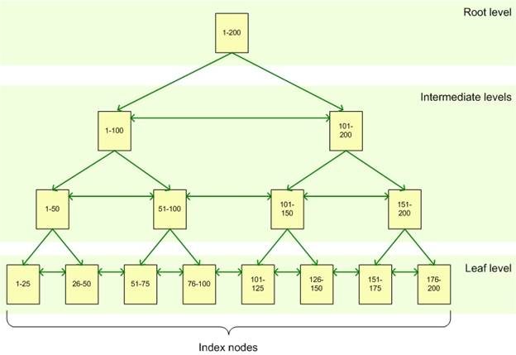
Indexes
An index is made up of a set of pages that are organised in a B-tree structure.
A query against an indexed column navigates down and gets more granular as it goes.
The leaf node will contain either the entire row of data or a pointer to that row, depending on whether the index is clustered or non-clustered.
Can help or hinder performance.

Slide 5
Clustered vs Non-Clustered
Clustered
Stores the actual data rows at the leaf level of the index.
Quickly returns the data because the data is part of the index.
Table is physically sorted in index order.
Usually the Primary Key – can only be one per table.
These keys are usually those which you use most commonly to identify and join.
Non-Clustered
Unlike a clustered index, the leaf nodes contain only the values from the indexed columns and row locations/pointers.
So basically, a non-clustered index includes the key value and a pointer that tells SQL where to find the actual row in the clustered index.
Logically organises data, doesn’t change the physical storage.
A table can have multiple indexes.

Slide 7
Non-Clustered Cont.
SQL Server uses a Key Lookup to retrieve non-key data from the data page when a non-clustered index is used to resolve the query. That is, once SQL Server has used the non-clustered index to identify each row that matches the query criteria, it must then retrieve the column information for those rows from the data pages of the table using the clustered index.
Key lookups can be costly too as the number of records increases.
Covering index – include other non-key columns in the index.

Slide 8
Query Performance
1. Write to your data structures and also take advantage of foreign key constraints and other structures.
2. Write for your indexes.
3. Write for the optimizer.

Slide 9
Query Tuning
Use both Statistics IO and execution plan together.
SET STATISTICS IO ON
CTRL+L – Estimated Execution Plan
CTRL+M – Actual Execution Plan

Slide 10
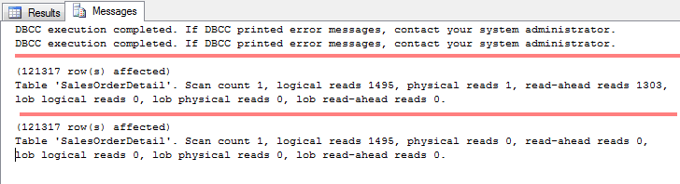
Statistics IO
Provides detailed information about the impact that your query has on SQL Server.
Aiming for least number of logical reads to perform your operation – faster response & lesser impact.
Scan Count - This number tells us that the optimizer has chosen a plan that caused this object to be read repeatedly. This number is used as a gauge later on in the process and you will see what object it is being scanned when you go over the execution plan. This number does not change unless you alter the query.
Logical Reads - Tells us the actual number of pages read from the data cache. This is the number to focus on because it does not change unless you change the actual query structure or index structures. Most common changes are the joins within the WHERE clause, parameter values, or index structures.

Slide 11
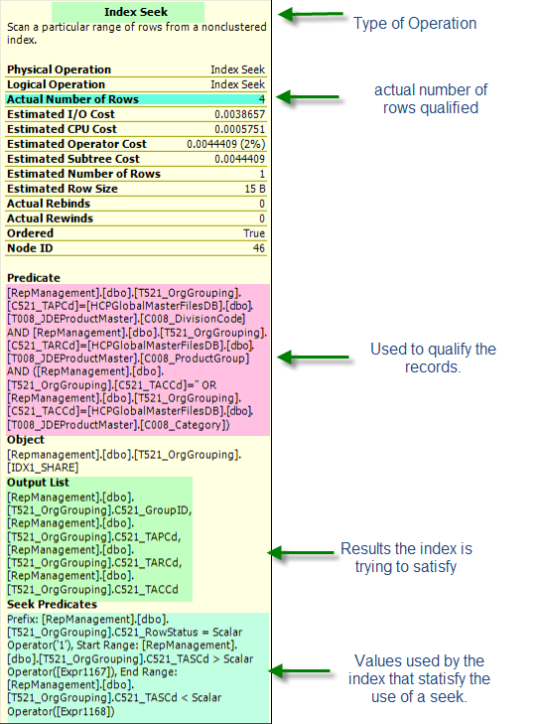
Execution Plans
Indexes referenced in three ways: Seek, Lookup, Scan.
The Predicate section shows you the all the pieces this index uses to qualify a row.
The Output List shows you what columns the index will be returning. If it can satisfy all columns it is a ‘covered’ index otherwise it will need additional columns.
The final section is Seek Predicates, which shows the actual columns, values, and criteria (<,>,=) used to satisfy the seek. If this were an Index Scan you wouldn’t see the Seek Predicates section.
Difference between seek predicate and predicate: Seek Predicate is the operation that describes the b-tree portion of the Seek. Predicate is the operation that describes the additional filter using non-key columns. Which is better?
Side note – you want the estimated rows and actual number of rows to be fairly close.

Slide 12
Practical Examples
Walkthrough some examples.

Slide 13
Good References
https://www.red-gate.com/simple-talk/sql/performance/simple-query-tuning-with-statistics-io-and-execution-plans/

